Slide 1
Table 4A
Please turn to page 345.

Slide 2
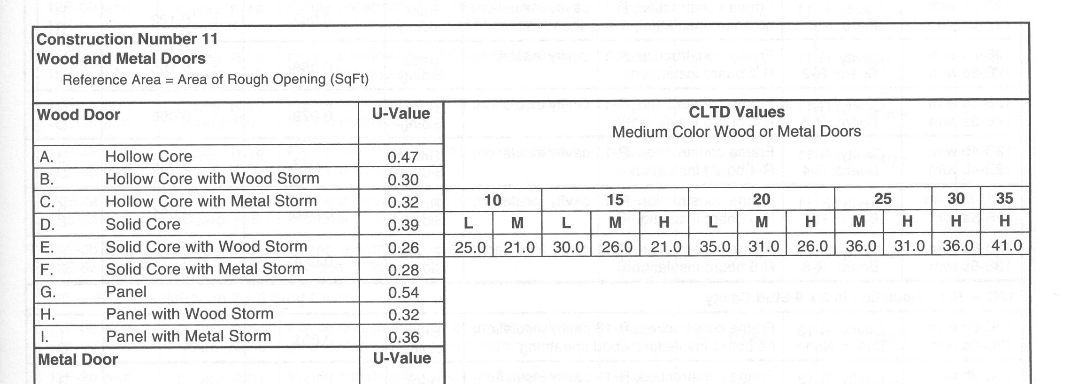
First determine the type of door your have.
Then you select the ‘U-Value.’

Slide 3
Then you determine the ‘CLTD Values.’
These are the ‘CLTD Values.’

Slide 4
You need the CTD value.
Plus the ‘Daily Range.’
To get the CLTD Values.

Slide 5
Please turn to page 346.

Slide 6
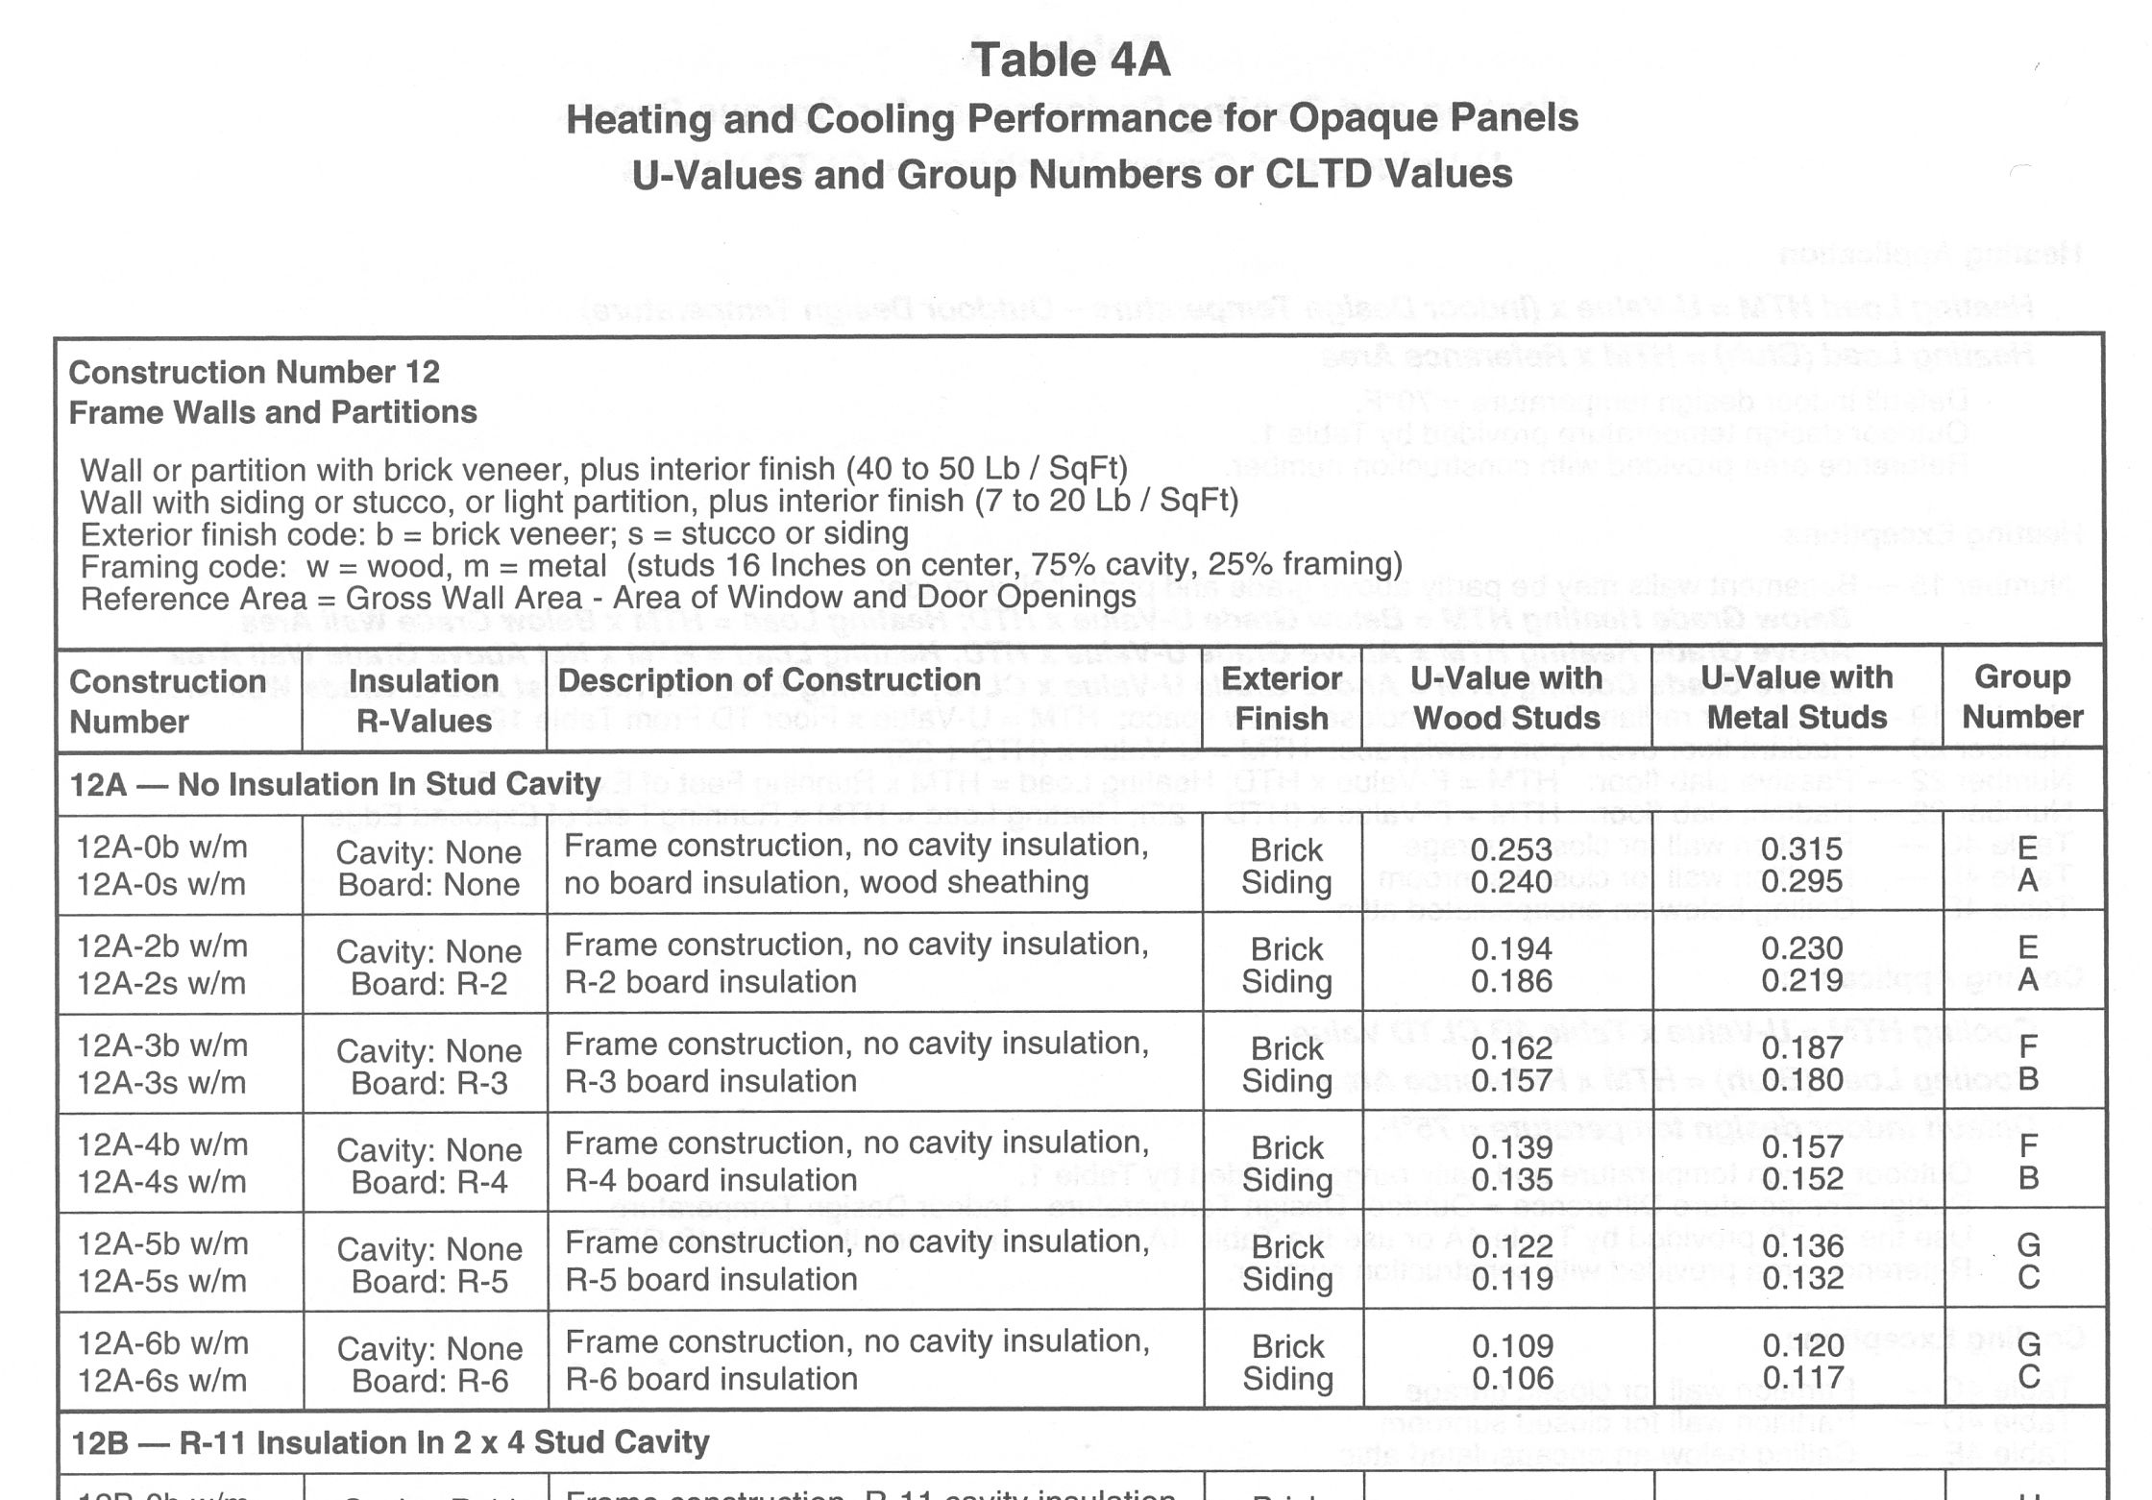
This section here has some
important information relative
to the ‘codes’ used in this table.
The first thing you need to do is to
find the ‘section’ of this table you
will need to get information from.
Table (continued)

Slide 7
Once you find the correct section, then you
focus on one row at a time, moving from row
to row until you get to the one that matches
your ‘Opaque Panel.’
What is important here is the ‘0’ and ‘b’ or ‘s.’
The ‘0’ is for the insulation value of the exterior
insulation board used. In this row, the ‘Board’
value is ‘0’ which means no board is used. The
‘b’ and ‘s’ is for the type of siding. ‘b’ is for brick
and ‘s’ is for stucco.

Slide 8
Next you need to determine the ‘U-Value’ and you
have two columns that need to be looked at. One
for wood studs and one for metal studs.
You will see two ‘U-Values’ in each box.
So which one is correct?

Slide 9
If the siding is brick, use this ‘U-Value’ for wood studs.
If the siding is stucco, use this ‘U-Value’ for wood studs.

Slide 10
One last thing you will have to determine is the ‘Group Number.’
If the siding is brick, use this ‘Group Number.’
If the siding is stucco, use this ‘Group Number.’

Slide 11
One more section of Table 4A to review, so
please turn to page 371.

Slide 12
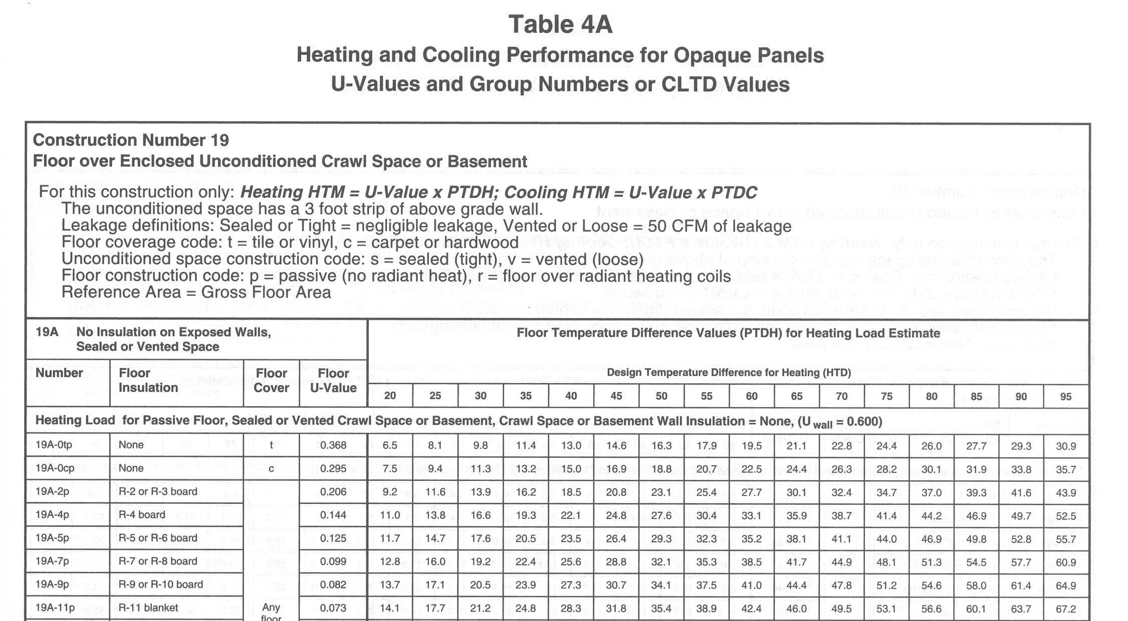
You will encounter this type of floor as you proceed
through the course.
As before, this section lists the ‘codes’ used in this table.

Slide 13
These two items are critical information. The first one
indicates the amount of insulation in the floor between
the joists. The second one indicates whether the floor
is (p) passive (no radiant heat) in the floor or (r) radiant
heat in the floor. So you have to know the amount of
insulation and whether the floor is (p) or (r).

Slide 14
The next information you will need is the ‘U-Value’ and
this is easy using the ‘Floor U-Value’ column.

Slide 15
The next information you will need is the ‘PTDH.’ This
entire section are the ‘PTDH’ values. So how do you
use it?

Slide 16
You need two pieces of information: the ‘Number’ for the
type of floor.
And the ‘HTD.’ The HTD is found on J1 Form in the
upper left corner, close to where the CTD is located.

Slide 17
For example, if the ‘Number’ for the
type of floor is:
And the ‘HTD’ is 70: The HTD is found on J1 Form in the
upper left corner, close to where the CTD is located.
Then the PTDH is going to be:

Slide 18
THE END

