Slide 1
Student Handout Packet
Go to page A4

Slide 2
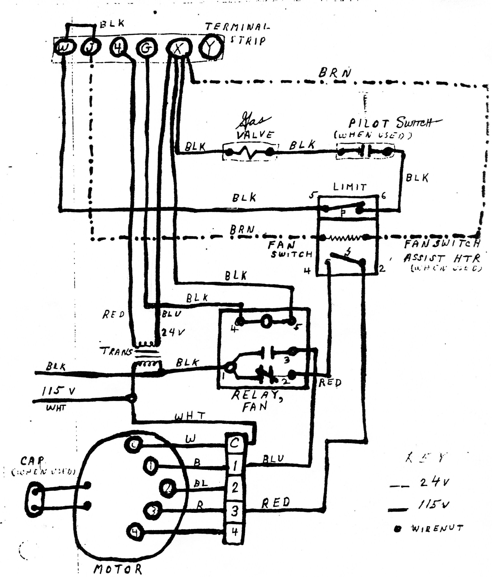

Slide 3
Please answer the following questions using page A4.

Slide 4
1. What type of single phase AC motor is found on this furnace?
You should observe that there are no starting relays (solid state, current coil, potential) on this motor. In addition, you should notice a capacitor and it is not identified. Since there are no starting relays, it cannot be a start capacitor and therefore has to be a run capacitor. Therefore, you should conclude that the motor is a ______________.

Slide 5
1. What type of single phase AC motor is found on this furnace?
You should observe that there are no starting relays (solid state, current coil, potential) on this motor. In addition, you should notice a capacitor and it is not identified. Since there are no starting relays, it cannot be a start capacitor and therefore has to be a run capacitor. Therefore, you should conclude that the motor is a __PSC motor___.

Slide 6
2. What is the source voltage to this furnace?
You should observe that even though this schematic does not follow the post-1987 NEC identification code, it does note not only the voltage, but also the color of the wires. So you should answer ________ as the source voltage.

Slide 7
2. What is the source voltage to this furnace?
You should observe that even though this schematic does not follow the post-1987 NEC identification code, it does note not only the voltage, but also the color of the wires. So you should answer __115v__ as the source voltage.

Slide 8
3. How many speeds does this furnace motor have?
Looking at just the motor, you should observe that there are 7 wires coming out of the motor. 2 for the capacitor and 1 for the ‘N’ of the line. Therefore, there are 4 wires left over and it would be a 4 speed motor. The method just used will work without looking at the schematic.

Slide 9
3. How many speeds does this furnace motor have?
If you look at the schematic you should observe that there are 4 wires labeled 1 through 4 and therefore a 4 speed motor. Thus, you have a 4 speed PSC motor, or otherwise known as a multi-speed PSC motor.

Slide 10
The key to analyzing a schematic is to know the symbols and their functions.
So we are now going to proceed with a step-by-step analysis of this schematic, looking at both the symbol and then the function of the component.

Slide 12
Locate the black and white wires coming in from the line. There is a note that indicates ‘115v.’ Therefore, there is 115v to this furnace and we will analyze the 115v circuit first.

Slide 14
Follow the black and white wires coming in from the line. You should notice that they connect to two wires on the transformer. The incoming power is connected to the primary of the transformer.

Slide 16
Now continue following the black wire and you should see that it connects to terminal 1 on the ‘Fan Relay.’

Slide 18
Fan Relay
The fan relay controls the fan, but how?
Notice there is a NO and a NC set of contacts.
Follow the NO contacts, out terminal 3, then to the motor. The NO contacts go to a ‘Blue’ wire. This is a high speed of the motor.

Slide 20
Fan Relay
4. Now go back to the fan relay, terminal 2, which is the NC contacts.
5. Follow the NC contacts, out terminal 2, then to the fan switch, and then to the fan motor. The fan switch goes to a ‘Red’ wire. This is a low speed of the motor.

Slide 22
Fan Relay
In conclusion, the fan relay controls the speed of the motor for heating and air conditioning.

Slide 23
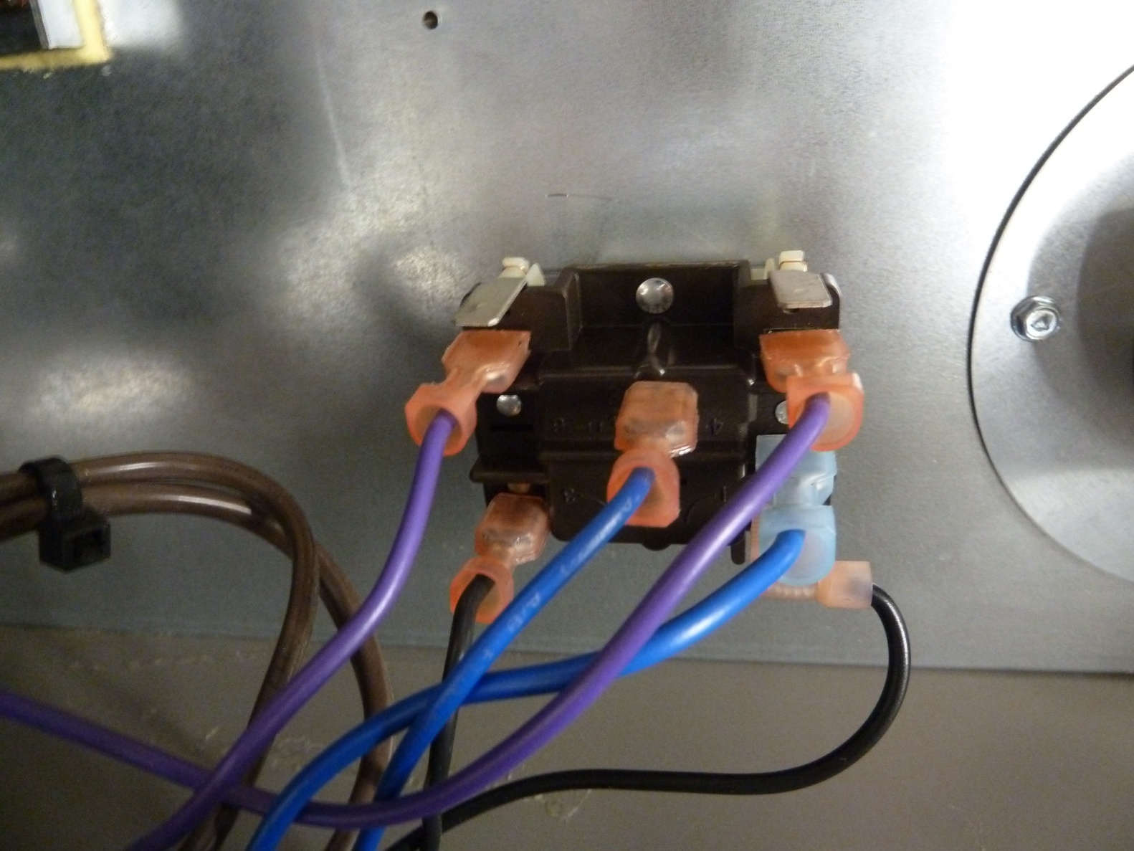
Fan Relay

Slide 24
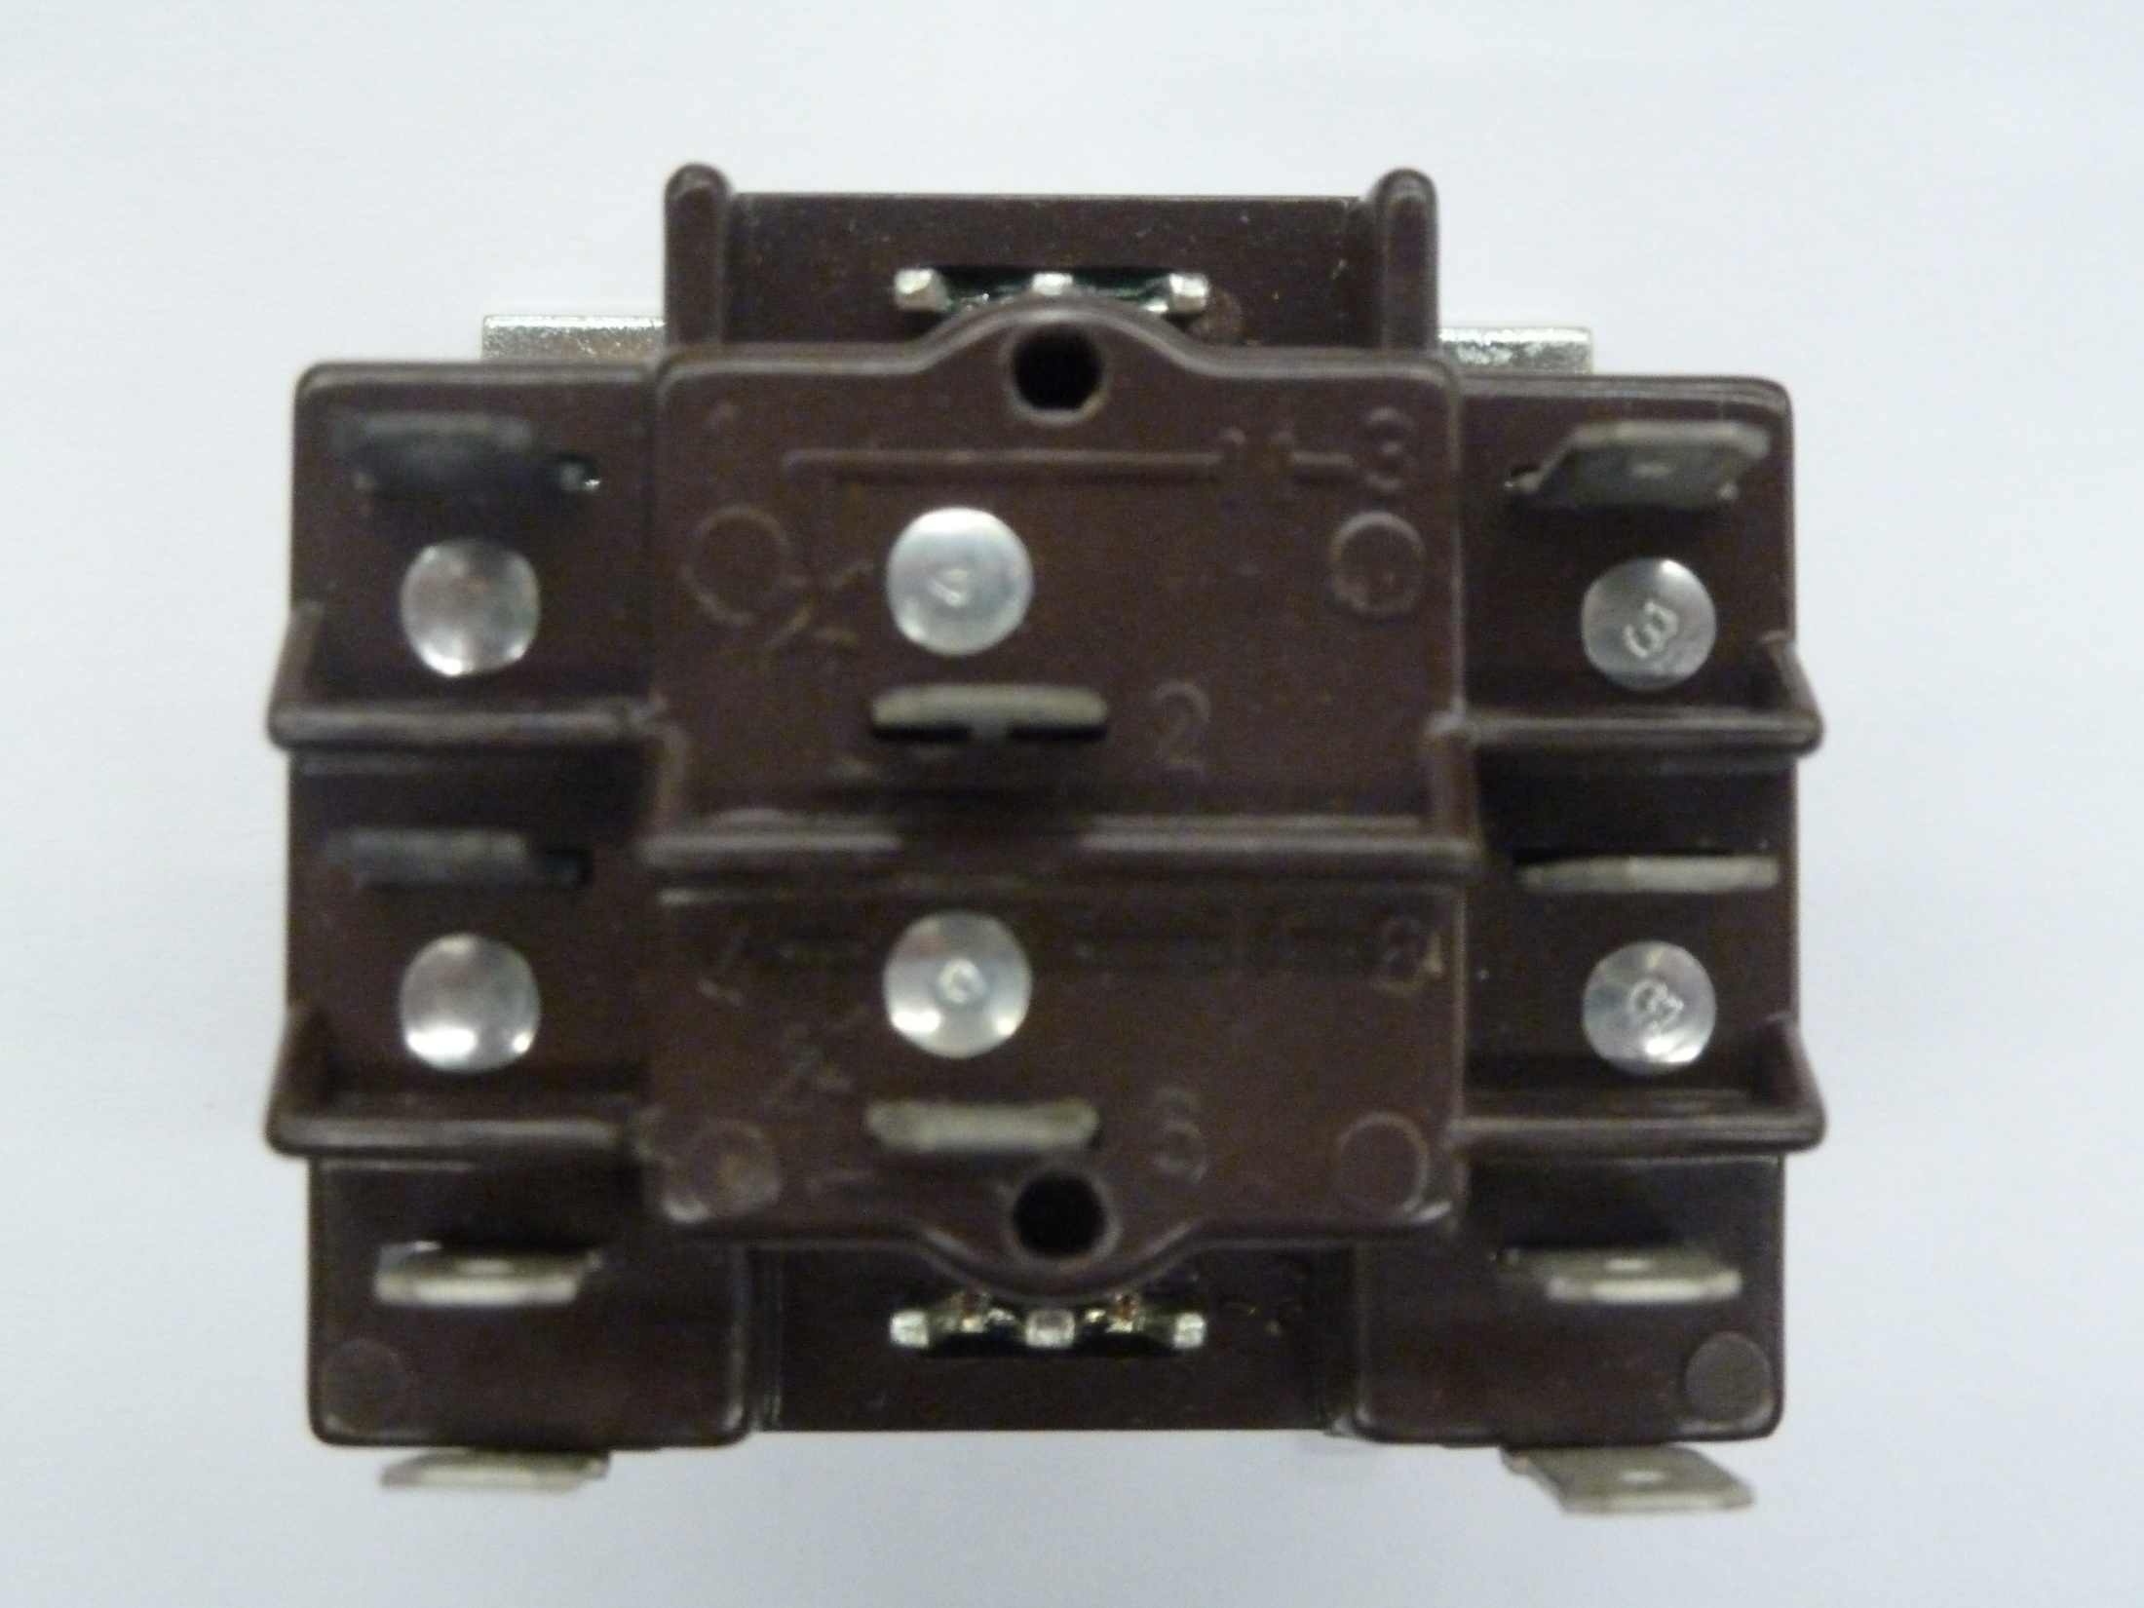
Terminal 1
Terminal 2
Terminal 3
The relay has a brown plastic cover with the terminal
numbers ‘raised’ on the housing for identification.

Slide 25
Moving onto the fan switch

Slide 26
Fan Switch
1. The fan switch controls the motor for heating.
2. Notice the fan switch is NO.
3. It closes on a rise in temperature.
4. It is physically located in a location on the furnace where it will ‘sense’ the heat from the heat exchanger.
5. It has a cut-in temperature setting, and this is the temperature which will make the contacts close and the fan will operate.

Slide 27
Fan Switch
6. It has a cut-out temperature setting and this is the temperature which will open the contacts and the fan will stop.
7. Some fan switches have adjustable CI and CO settings. Some have fixed CI and CO settings.

Slide 28
Fan Switch
8. A likely CI will be 130ºF.
9. A likely CO will be 100ºF.
10. The DIFFERENTIAL will be 30º, in this example.
11. The fan switch is ALWAYS in the ‘POWER’ or line voltage circuit.

Slide 29
Return to page A4 and we will follow the low voltage, 24v, of this circuit.
Look for the secondary of the transformer and identify the two wire colors as red and blue.

Slide 31
Follow the RED wire and it goes to the ‘Terminal Strip’ terminal 4. The red wire from the transformer is considered the ‘hot’ wire of the 24v system. The hot wire for a120v or 240v system is identified as ‘H.’ In order to eliminate confusion, please mark this wire a ‘P’ or power for the low voltage circuit.

Slide 32
P

Slide 33
Follow the BLUE wire and it goes to the ‘Terminal Strip’ terminal X. The blue wire from the transformer is considered the ‘reference’ or return wire of the 24v system. Since the ‘reference’ wire on a 120v circuit has been given the letter designation ‘N’ it would be best not to use this letter for the reference of the 24v circuit. We will use ‘C’ to represent the common return for all the 24v loads.

Slide 34
P
C

Slide 35
Return to page A4 and ADD the symbol and information that you will see on the next slide in the upper left corner to your page A4.

Slide 36
W
R
P
C

Slide 37
You added a thermostat, just like you would on the installation of a furnace.
1. You would connect terminal strip terminal 4 to the thermostat terminal R. 2. You would connect terminal strip terminal W to the thermostat terminal W.

Slide 38
W
R
P
C

Slide 39
We will now analyze the 24v circuit, its symbols and functions.

Slide 40
Start at the RED wire or ‘P’ side of the transformer and follow this wire to terminal 4 of the terminal strip.

Slide 41
W
R
P
C

Slide 42
Now continue from terminal 4 of the terminal strip to terminal R of the thermostat. Then continue through the thermostat and leave the thermostat through terminal W to the terminal strip terminal W.

Slide 43
W
R
P
C

Slide 44
Thermostat
1. The thermostat shown is used for heating. The symbol tells us that it is a heating thermostat.
2. Terminal R on the thermostat is the terminal where the ‘P’ or 24v power side of the transformer gets connected.
3. We leave the thermostat on terminal W. Terminal W is the identification code for the terminal used for ‘Heating.’

Slide 45
Now continue on the schematic from terminal W of the terminal strip and the electrons will flow to the LIMIT.

Slide 46
W
R
P
C

Slide 47
Limit
1. The limit is shown with NC contacts.
2. The limit is used to provide safety in the event the temperature of the equipment should exceed a safe operating level.
3. Notice the limit is wired in series with the gas valve so that when the NC contacts open, the gas valve will be de-energized and close.

Slide 48
Limit
4. The limit has a cut-out that is usually around:
a. 200ºF for barometric draft furnaces
b. 180ºF for high efficiency furnaces
c. or whatever the manufacturer specifies
5. The limit may be a separate component or it may be part of the same housing of the fan switch, as it is shown on page A4. In this situation the components are called a ‘combination fan/limit switch.’

Slide 49
Limit
6. The limit may be located in the CONTROL circuit, which is 24v. Or it may be located in the POWER circuit, which is the line voltage to the equipment.

Slide 50
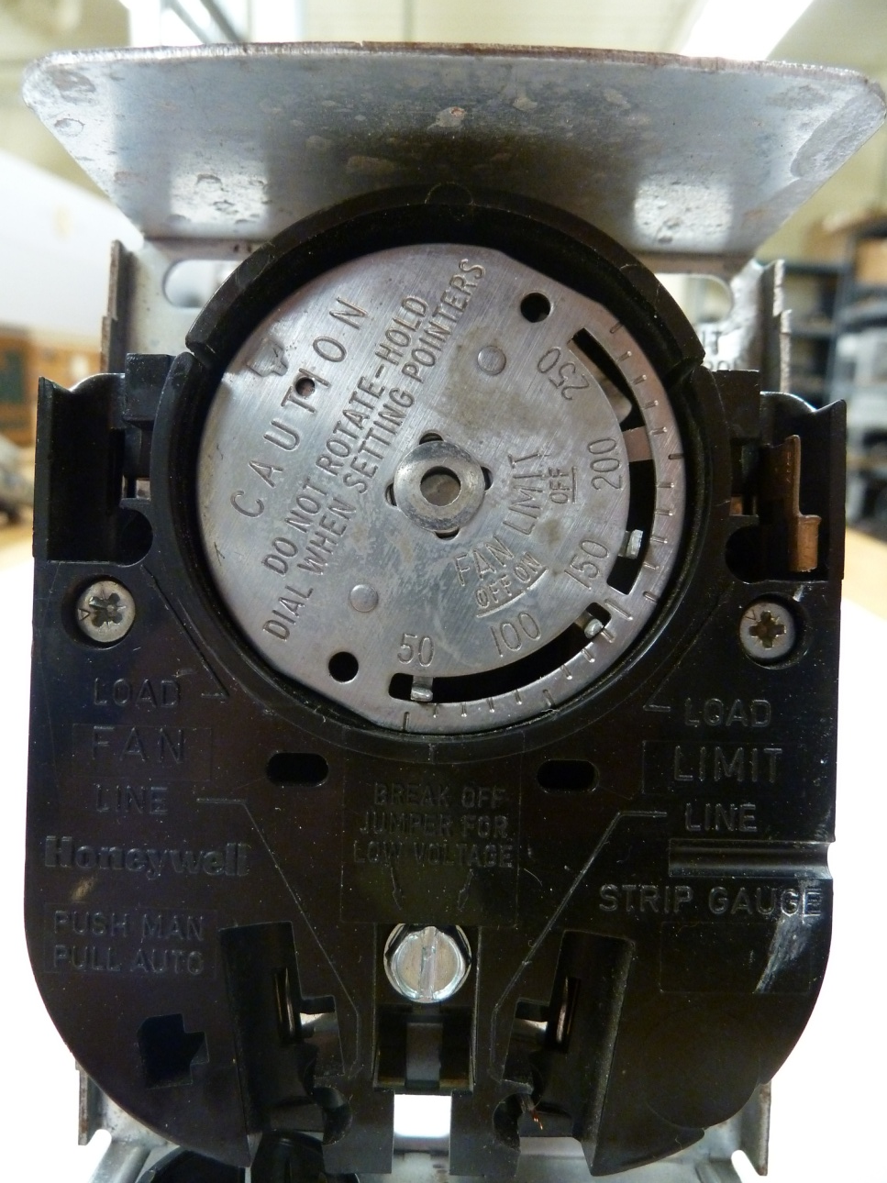
Example of a Fan/Limit

Slide 51
Now continue on the schematic from the LIMIT and you will come to the ‘PILOT SWITCH.’

Slide 52
W
R
P
C

Slide 53
Pilot Heat Switch
The ‘Pilot Heat Switch’ responds to heat. What you need to observe is the symbol on page A4. If the pilot heat switch is responsive to heat, then it should not have been drawn so that it appears to be a set of contacts.

Slide 54
Pilot Heat Switch
This is the way it should have been drawn.
So be careful, things may not seem to be as they are.

Slide 55
Now continue on the schematic from the ‘PILOT SWITCH’ and you will come to the ‘GAS VALVE.’

Slide 56
W
R
P
C

Slide 57
Gas Valve
The ‘Gas Valve’ is a solenoid valve which is either open or closed. When open, gas flows to the manifold and then the burners. When closed, no gas flows.

Slide 58
Now continue on the schematic from the ‘GAS VALVE’ through the terminal strip terminal X and you will be returning to the secondary side of the transformer, this time on the ‘C’ or reference side.

Slide 59
W
R
P
C

Slide 60
You just finished following a schematic and analyzed the components as you proceeded through the circuit, component to component, wire to wire and terminal to terminal.

Slide 61
Continue onto the next presentation in this series. Look for the title, ‘Gas Furnace Controls – Part 2.’

Slide 62
The End

