Slide 1
NEC Wiring Diagrams

Slide 2
L1
N
L2
1
3
5
7
9
11
2
4
6
8
10
12
Neutral Bar
Bonding
Screw

Slide 3
L1
N
L2
1
3
5
7
9
11
2
4
6
8
10
12
Neutral Bar

Slide 4
L1
N
L2
1
3
5
7
9
11
2
4
6
8
10
12
Neutral Bar

Slide 5
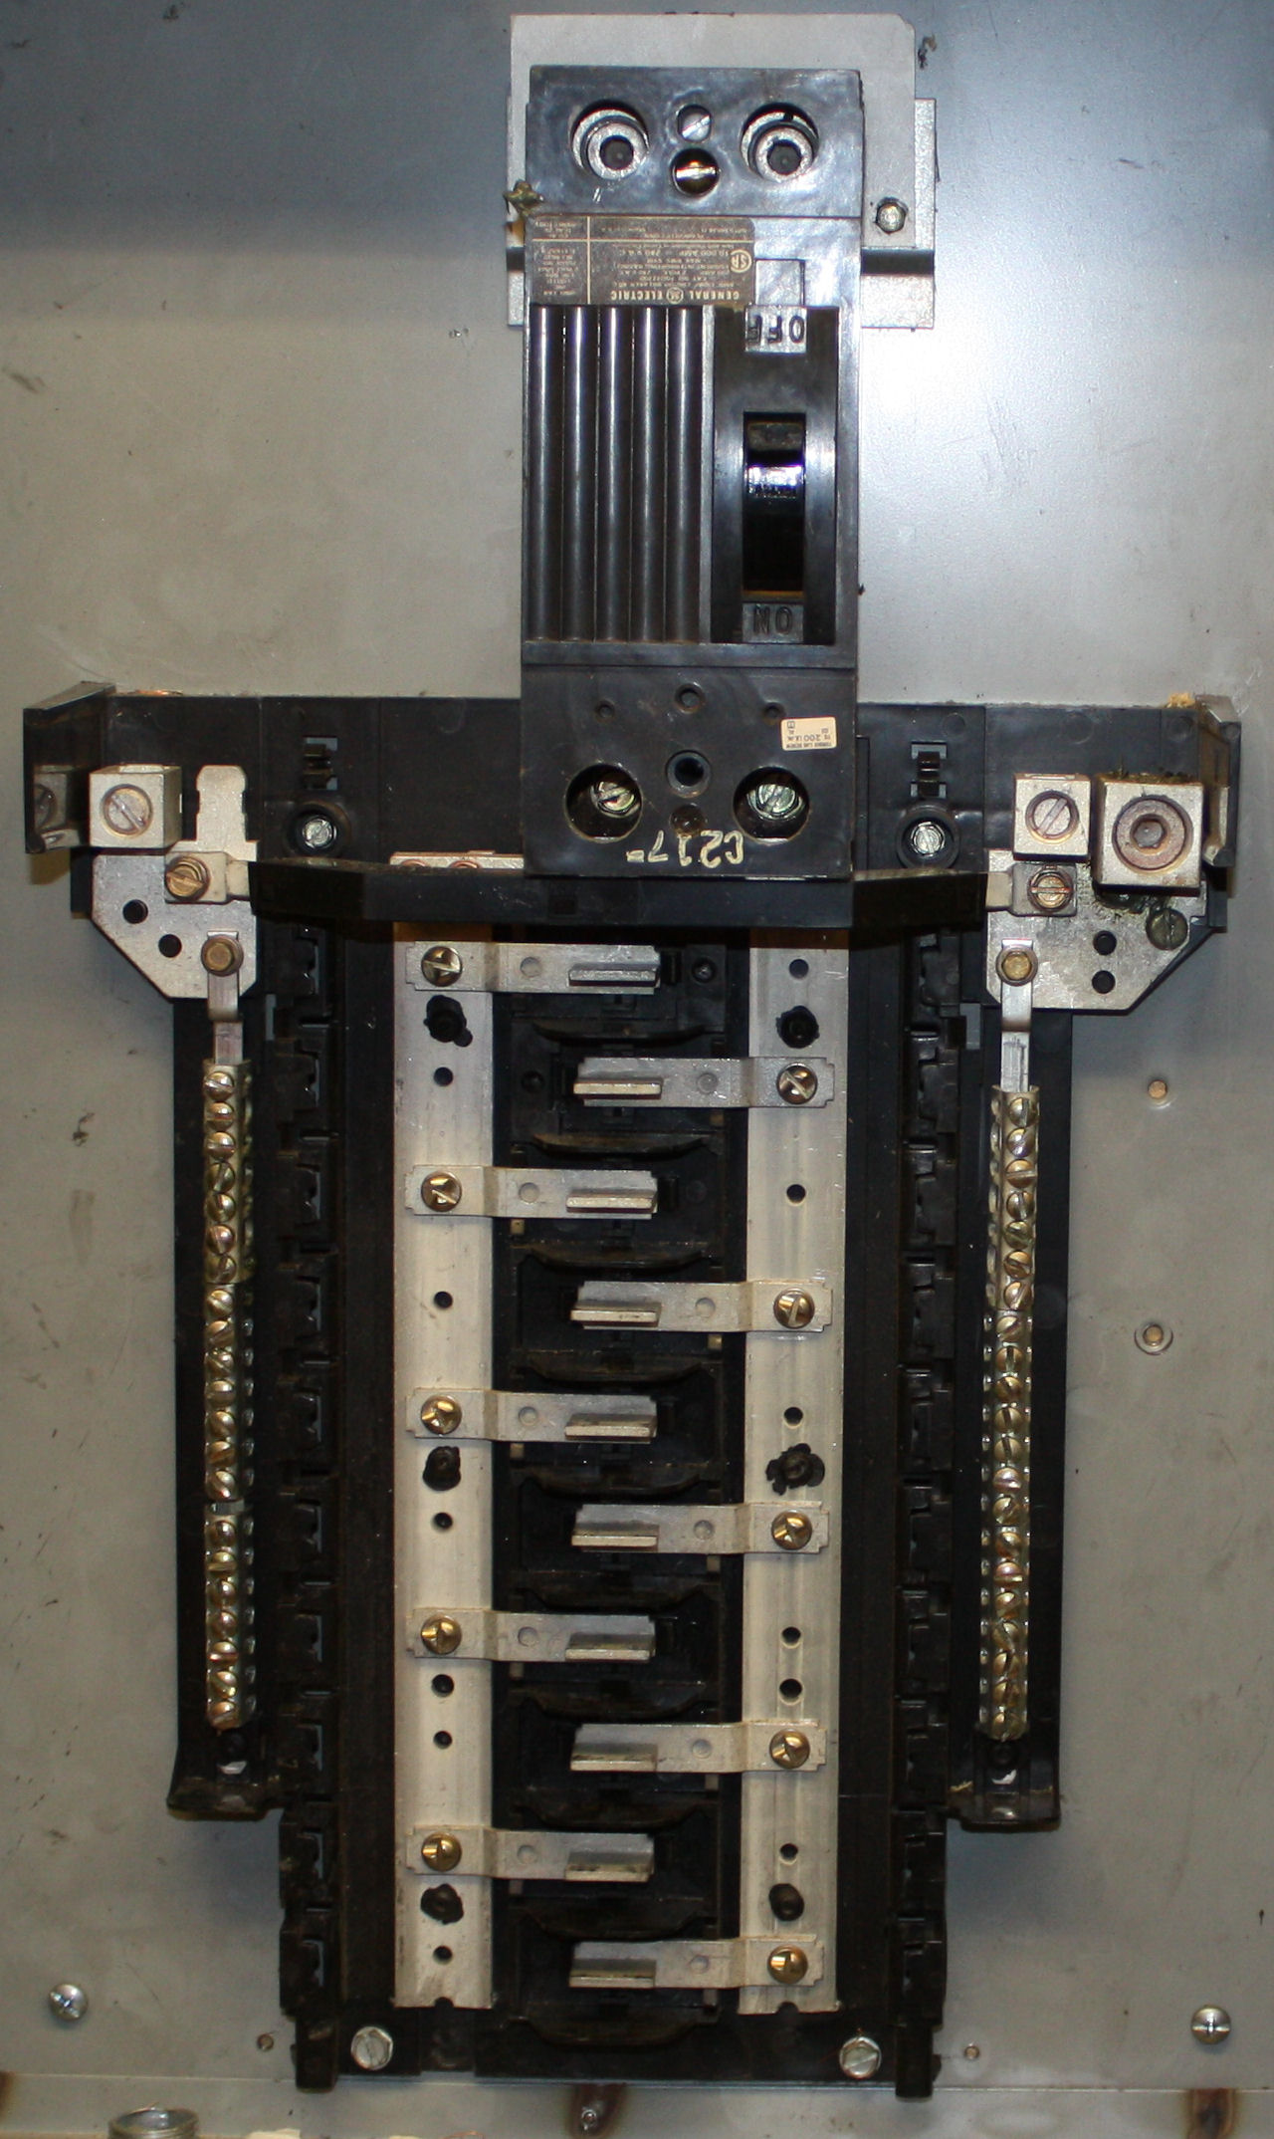

Slide 6
L1 comes in here
L2 comes in here

Slide 7
L1 comes in here
L2 comes in here
Main Disconnect

Slide 8
L1 comes in here
L2 comes in here
Main Disconnect
L1 busbar
L2 busbar

Slide 9
L1 comes in here
L2 comes in here
Main Disconnect
Circuit
Breaker
Lugs

Slide 10
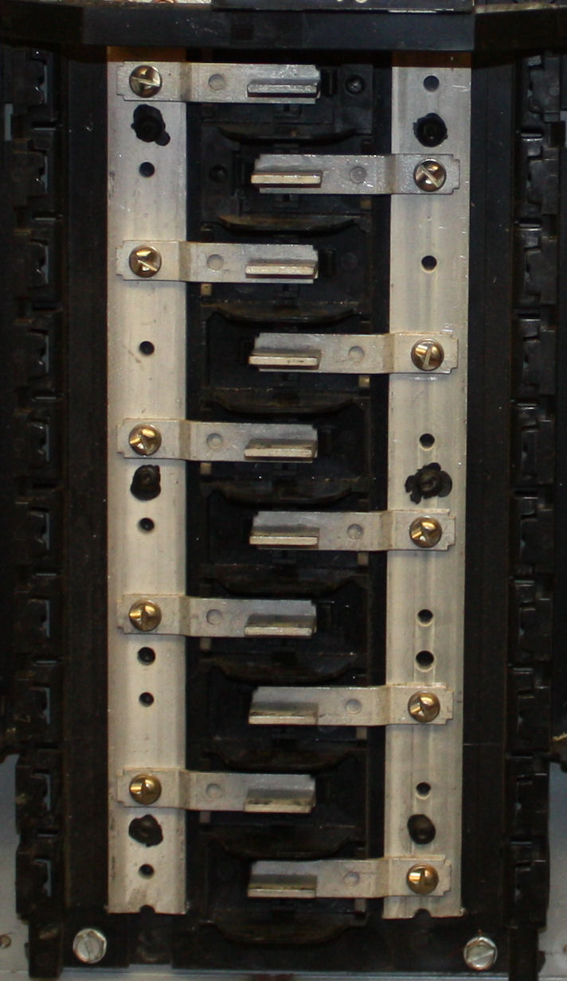
1
3
5
7
9
11
13
15
17
19
2
4
6
8
10
12
14
16
18
20
Breaker
Positions

Slide 11
L1 comes in here
L2 comes in here
Neutral
Connection
Neutral Busbar +
Grounding
Connections
if a Main Panel

Slide 12
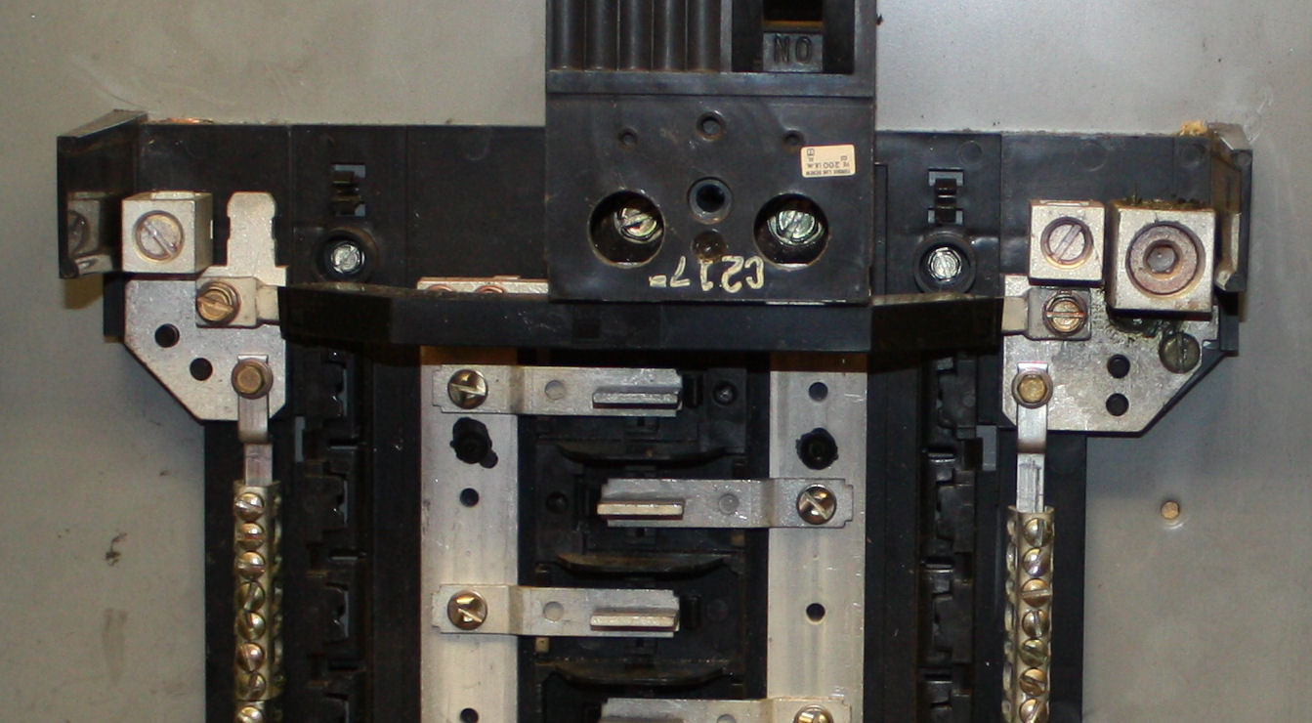
Neutral Crossover
Bar
Bonding
Screw

Slide 13
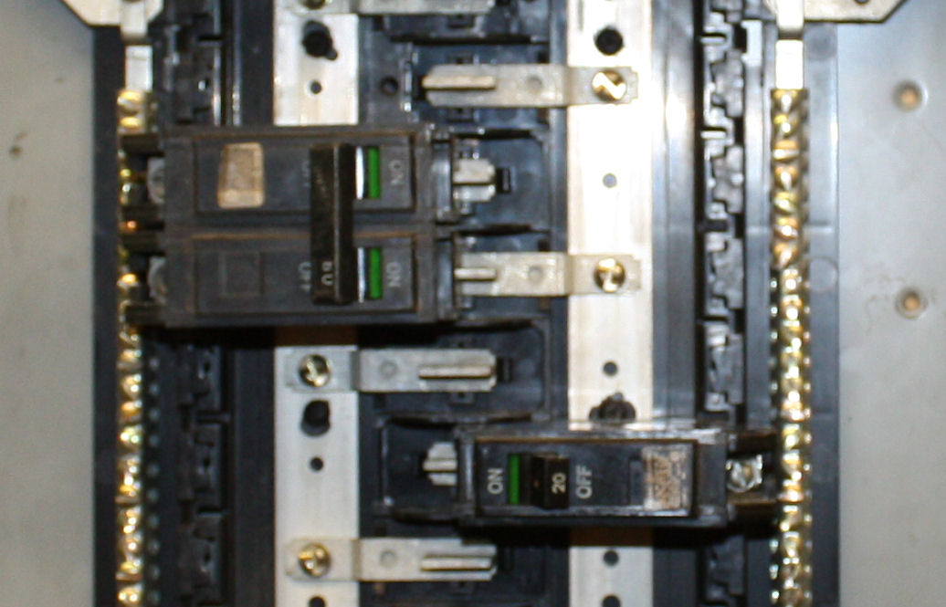
DP Breaker
L1 Connection
L2 Connection

Slide 14
SP Breaker
L2 Connection

Slide 15
Let’s Wire Some Circuits

Slide 16
L1
N
L2
1
3
5
7
9
11
2
4
6
8
10
12
S1
Hot
Neutral Bar
Switched

Slide 17
L1
N
L2
1
3
5
7
9
11
2
4
6
8
10
12
S1
Hot
Neutral Bar
Switched

Slide 18
L1
N
L2
1
3
5
7
9
11
2
4
6
8
10
12
S1
Hot
Neutral Bar
Switched

Slide 19
L1
N
L2
1
3
5
7
9
11
2
4
6
8
10
12
S1
Hot
Neutral Bar
Switched

Slide 20
L1
N
L2
1
3
5
7
9
11
2
4
6
8
10
12
S1
Hot
Neutral Bar
Switched

Slide 21
L1
N
L2
1
3
5
7
9
11
2
4
6
8
10
12
S1
Hot
Neutral Bar
Switched

Slide 22
L1
N
L2
1
3
5
7
9
11
2
4
6
8
10
12
S1
Hot
Neutral Bar
Switched

Slide 23
L1
N
L2
1
3
5
7
9
11
2
4
6
8
10
12
S1
Hot
Neutral Bar
Color of Wires?
Switched

Slide 24
L1
N
L2
1
3
5
7
9
11
2
4
6
8
10
12
Neutral Bar
Duplex
Outlet
120 v

Slide 25
L1
N
L2
1
3
5
7
9
11
2
4
6
8
10
12
Neutral Bar
Duplex
Outlet
120 v

Slide 26
L1
N
L2
1
3
5
7
9
11
2
4
6
8
10
12
Neutral Bar
Duplex
Outlet
120 v

Slide 27
L1
N
L2
1
3
5
7
9
11
2
4
6
8
10
12
Neutral Bar
Duplex
Outlet
120 v

Slide 28
L1
N
L2
1
3
5
7
9
11
2
4
6
8
10
12
Neutral Bar
Duplex
Outlet
120 v
Color of Wires?

Slide 29
L1
N
L2
1
3
5
7
9
11
2
4
6
8
10
12
Neutral Bar
240v ONLY

Slide 30
L1
N
L2
1
3
5
7
9
11
2
4
6
8
10
12
Neutral Bar
240v ONLY

Slide 31
L1
N
L2
1
3
5
7
9
11
2
4
6
8
10
12
Neutral Bar
240v ONLY

Slide 32
L1
N
L2
1
3
5
7
9
11
2
4
6
8
10
12
Neutral Bar
240v ONLY

Slide 33
L1
N
L2
1
3
5
7
9
11
2
4
6
8
10
12
Neutral Bar
240v ONLY

Slide 34
L1
N
L2
1
3
5
7
9
11
2
4
6
8
10
12
Neutral Bar
240v ONLY
Color of Wires?

Slide 35
L1
N
L2
1
3
5
7
9
11
2
4
6
8
10
12
S3
Neutral Bar
120 v
S3

Slide 36
L1
N
L2
1
3
5
7
9
11
2
4
6
8
10
12
S3
Neutral Bar
120 v
S3

Slide 37
L1
N
L2
1
3
5
7
9
11
2
4
6
8
10
12
S3
Neutral Bar
120 v
S3

Slide 38
L1
N
L2
1
3
5
7
9
11
2
4
6
8
10
12
S3
Neutral Bar
120 v
S3

Slide 39
L1
N
L2
1
3
5
7
9
11
2
4
6
8
10
12
S3
Neutral Bar
120 v
S3

Slide 40
L1
N
L2
1
3
5
7
9
11
2
4
6
8
10
12
S3
Neutral Bar
120 v
S3

Slide 41
L1
N
L2
1
3
5
7
9
11
2
4
6
8
10
12
S3
Neutral Bar
120 v
Color of Wires?
S3

Slide 42
THE END

