Slide 1
Motor Information

Slide 2
HOUSINGS
Shown on the next several slides are a sample of some of the motor housings or enclosures that are available. This is by no means exhaustive.

Slide 3
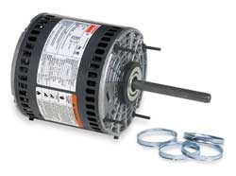
OPEN – Air Over – A.O.
Ex.: Furnace Fan

Slide 4
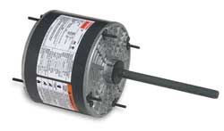
Totally Enclosed – Water Proof
Ex.: Outdoor Condenser

Slide 5
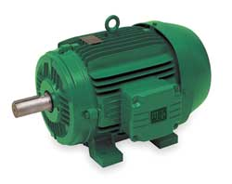
Totally Enclosed
Hazardous Location

Slide 6
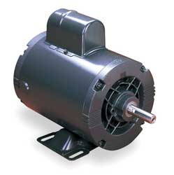
OPEN – Drip Proof

Slide 7
Single Phase Motor Types
Split Phase
Shaded Pole
(PSC) – Permanent Split Capacitor
(CS) – Capacitor Start
(CSR) – Capacitor Start Run

Slide 8
Three Phase Motor Types
Delta Configuration
Wye Configuration

Slide 9
DC Motor that works on AC
Known as a ‘Universal’ motor because it can work on AC or DC. It has some unique characteristics that we will review later in the course.

Slide 10
Starting Devices
All of the following devices are used with single phase motors.
Centrifugal Switch
Hot Wire Relay – no longer used
Current Relay
Solid State Relay
Potential Relay

Slide 11
Starting Devices
Three phase motors are ‘self starting’ and do not require a ‘starting relay.’ Because of this, they are easier to troubleshoot.

Slide 12
Motor/Compressor Configurations
The HVACR industry uses compressors which require a motor to drive the compressor. Therefore, there are three configurations.

Slide 13
1. Hermetic
The word hermetic means ‘sealed.’ So both the motor and the compressor share the same shaft and they are both put in a housing and welded closed, thus ‘sealed.’ They are sometimes referred to as a ‘tin can’ or ‘welded’ compressor.

Slide 14
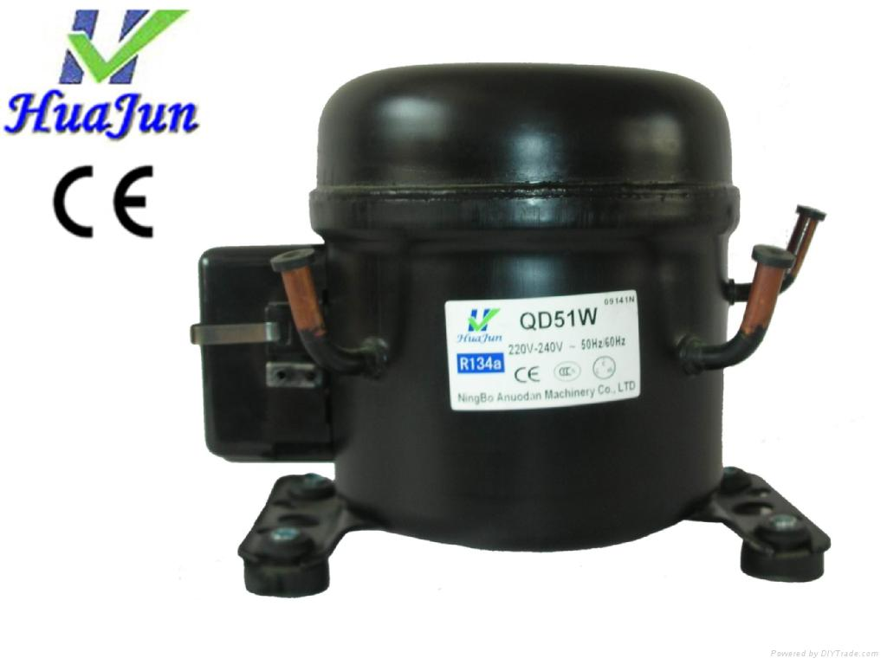

Slide 15
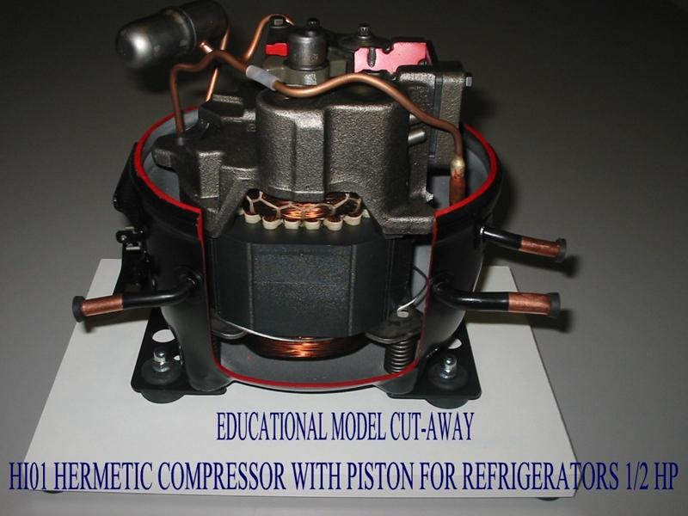

Slide 16
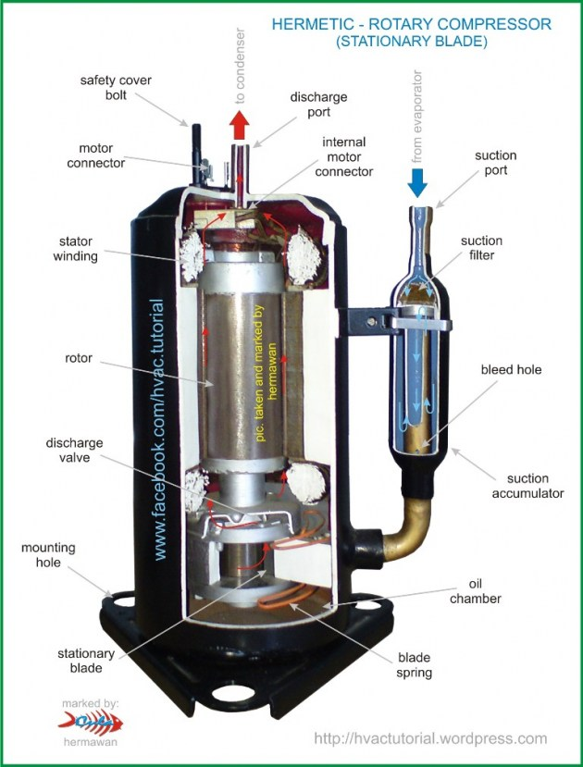

Slide 17
2. Semi-Hermetic (sometimes referred to as semi-open)
The motor and the compressor share the same shaft and the housing is accessible. In other words, the motor can be accessed for repair and the compressor can be accessed for repair.

Slide 18
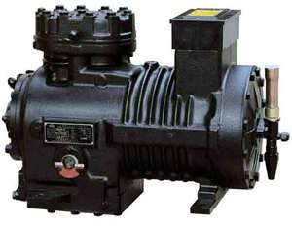

Slide 19
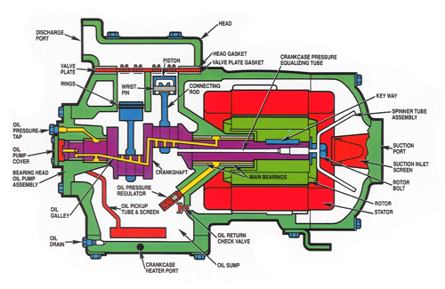

Slide 20
3. Open
The motor and the compressor DO NOT share the same shaft and therefore requires a belt or coupling to connect the motor to the compressor.

Slide 21
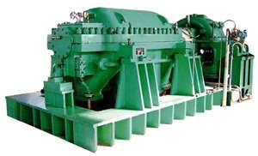

Slide 22
T h e
E n d

