Slide 1
K1 Schematic Analysis and Pictorial Diagram

Slide 2
Turn to page K1 in the Student Handout Packet
Answer the following questions.

Slide 3
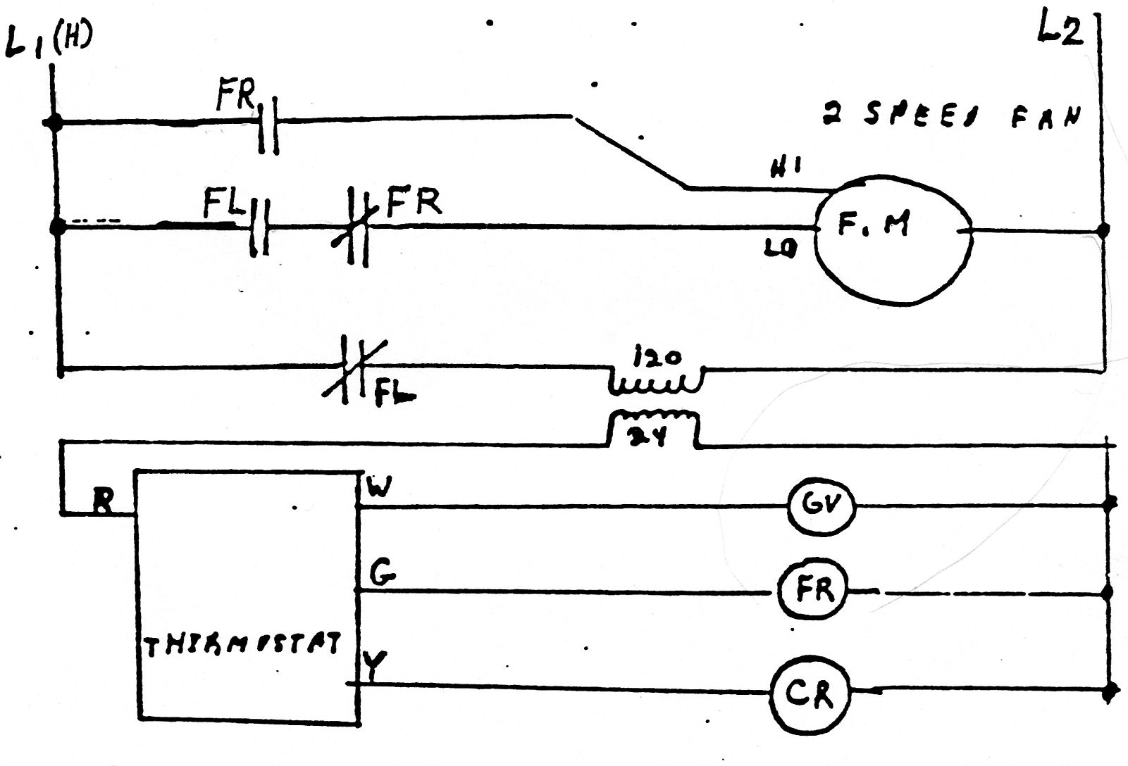
What type of single phase motor is on this equipment?

Slide 4
When you look at the motor and there are no starting relays nor capacitors, there is only one choice.
Did you answer: shaded pole.

Slide 5
What is the switching action of the FR (fan relay)?

Slide 6
Look at the NO contacts. Where do the contacts get power from?
Did you answer: L1 (H)
This becomes one ‘input.’

Slide 7
What is the switching action of the FR (fan relay)?

Slide 8
Look at the NC contacts. Where do the contacts get power from?
Did you answer: the FL.
This becomes a second ‘input.’

Slide 9
What is the switching action of the FR (fan relay)?

Slide 10
So this FR has two inputs, which is called ‘double pole.’ There is one open contact and one closed contact. So what is the switching action?
Did you answer:
DPST – 1NO, 1NC

Slide 11
Does the FL have a jumper or not?

Slide 12
Where does the FL – closed contacts, and the FL – open contacts get power from?
Did you answer: L1 (H)
See the next slide for help.

Slide 13
Does the FL have a jumper or not?
It has a jumper because power comes
into the FL open contacts and ‘jumps’
over to the closed contacts.

Slide 14
What does the FL abbreviation mean?

Slide 15
What does the abbreviation FL mean?
Did you answer:
Combination FAN and LIMIT
2 in one housing

Slide 16
Which one is the fan and which one is the limit?
Did you answer:
NO contacts is the FAN
NC contacts is the LIMIT

Slide 17
What does the FL abbreviation mean?
FAN SWITCH
LIMIT SWITCH

Slide 18
You will now draw the Pictorial by following the Schematic

Slide 19
Turn to page K1a and you will see 1. the 24 v circuit is completed. 2. there is a square ‘junction box’ that the wires will run from this box.
So let’s get started.

Slide 20
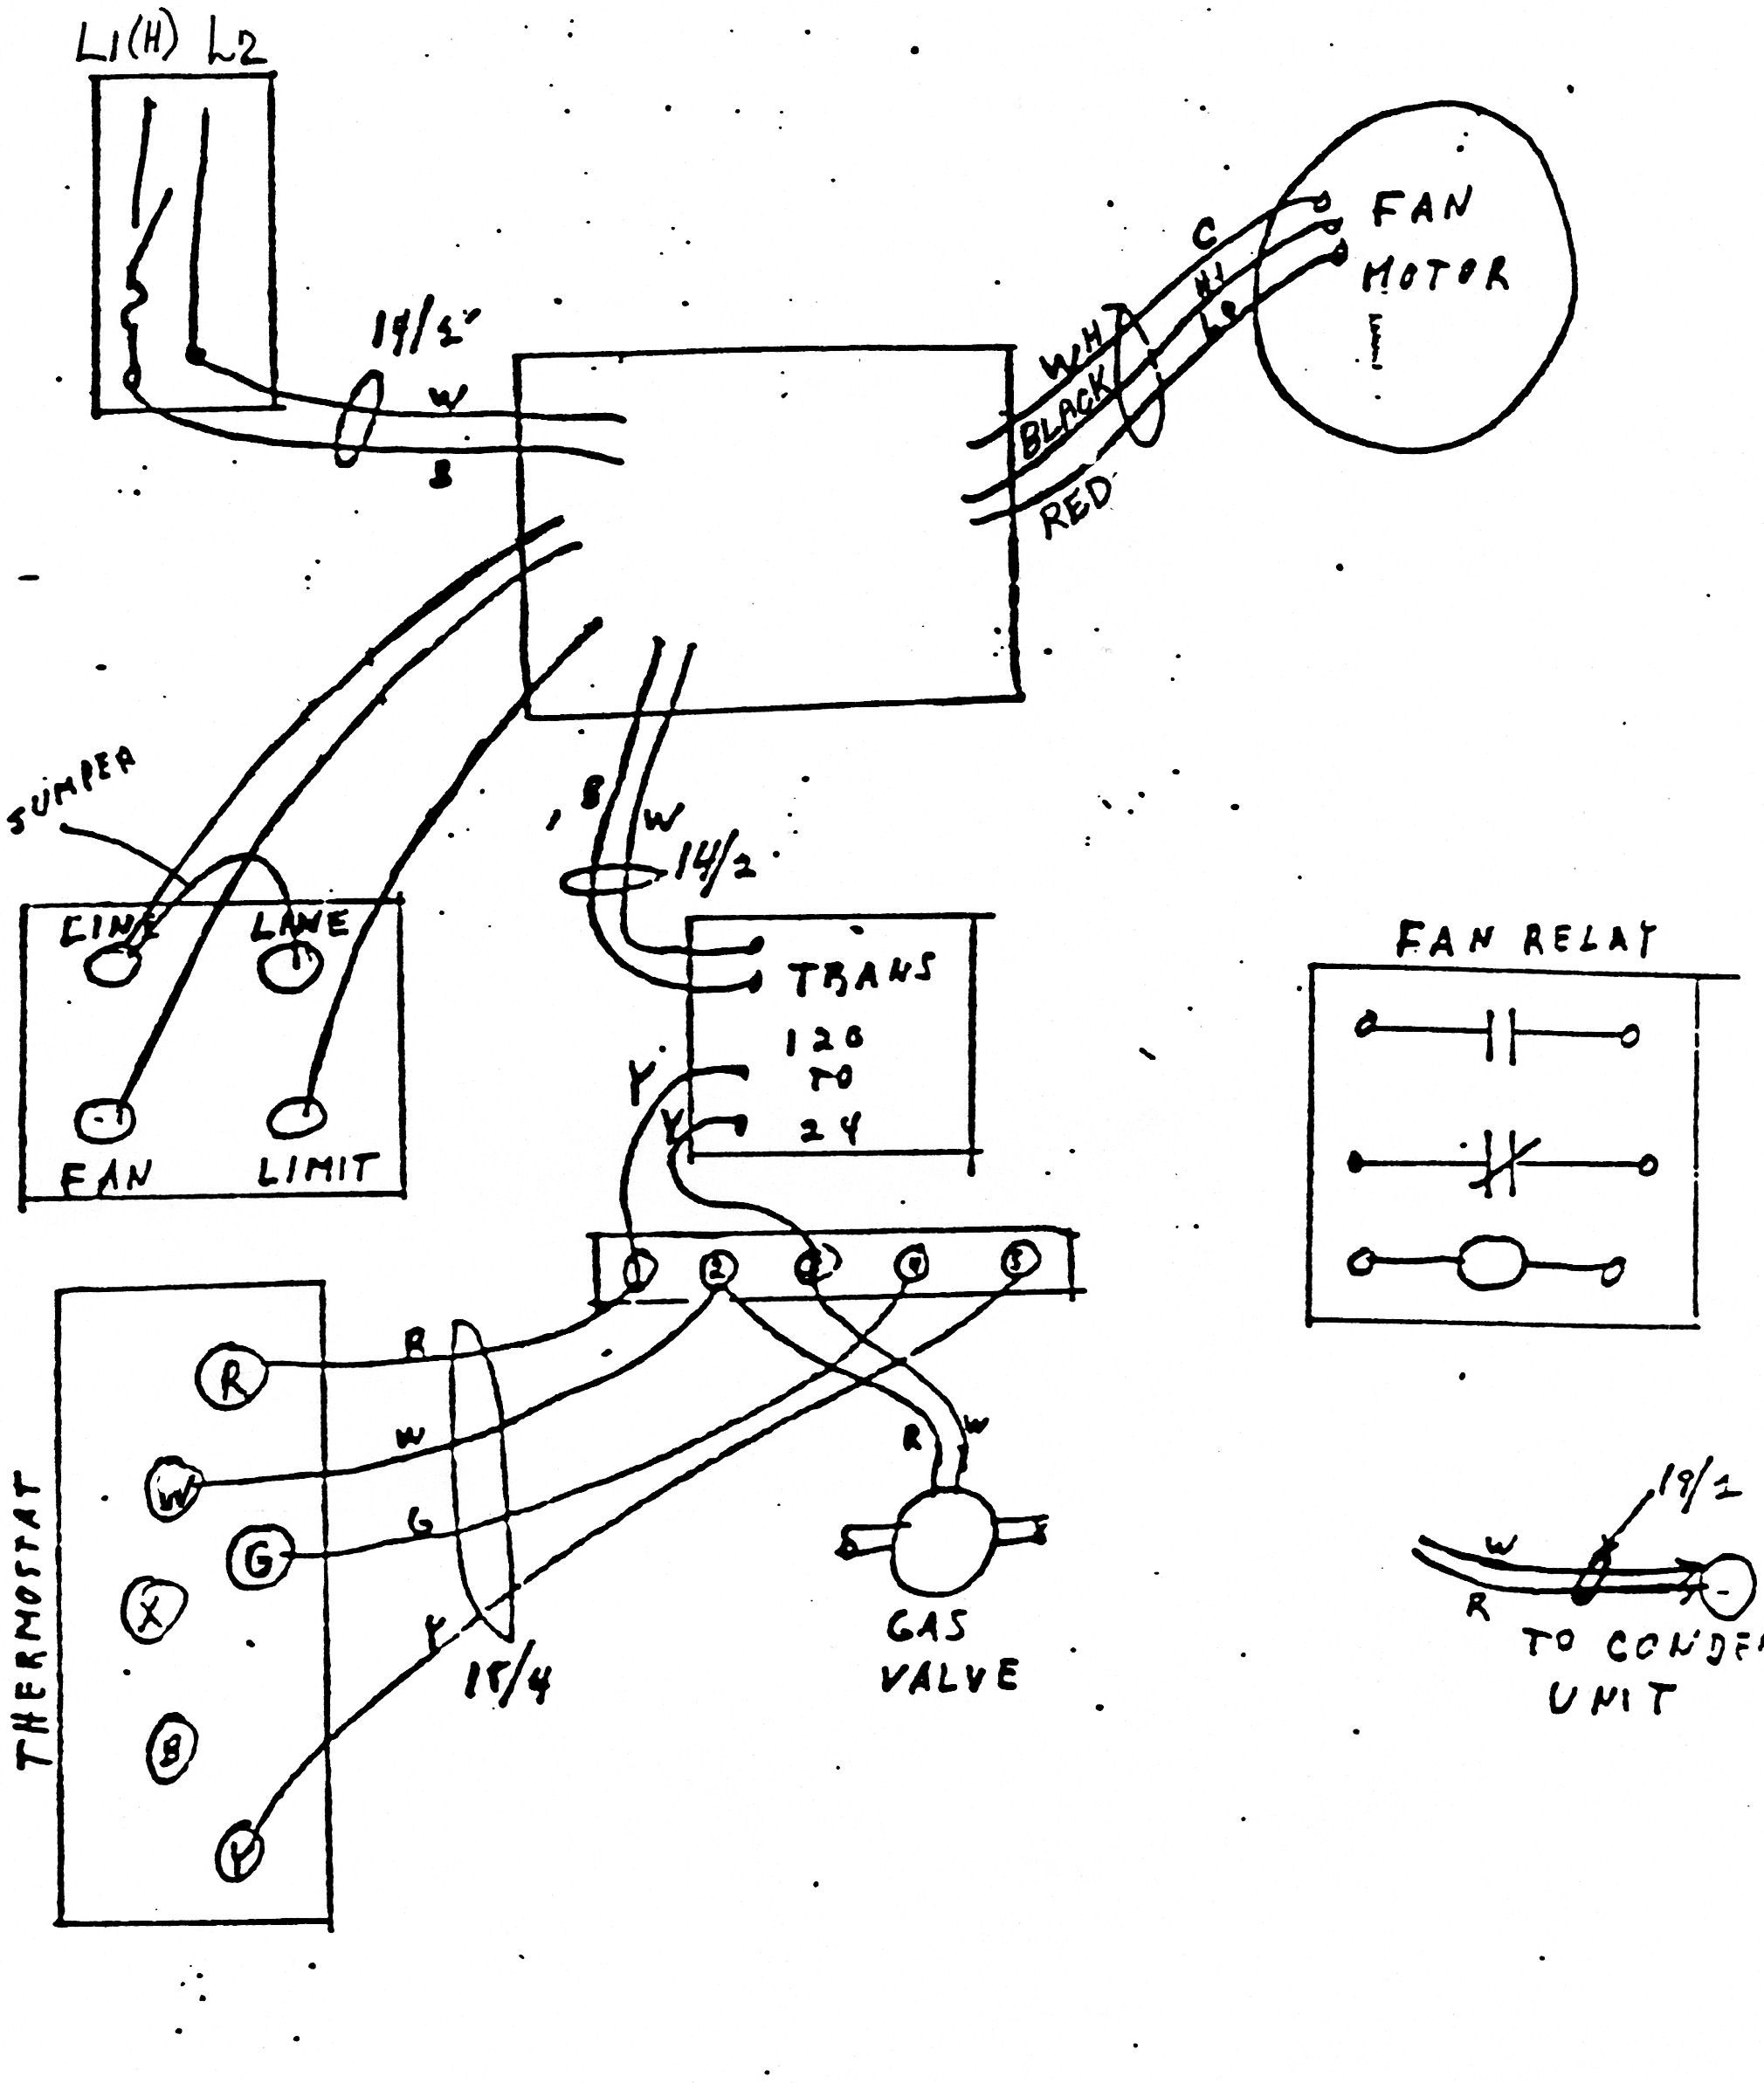
Square Box
Low Voltage

Slide 21
The process will be to follow the schematic one wire at a time from one component to another component until we are finished.

Slide 22
The slides that follow will show the wire in RED on the schematic that is going to be wired on the pictorial. Then the pictorial slide will show that wire being ‘installed.’ That is the wire you are to place on your pictorial. Keep advancing through the slides until you are finished with the pictorial.

Slide 29
Notice that you are coming from L1 to the combination FL,
and it has a jumper.

Slide 30
Don’t forget a ‘dot’ here
to indicate a connection.
Please observe jumper.

Slide 40
You have finished a pictorial following a schematic

Slide 41
The end

