Slide 1
G2 to G2a LINE VOLTAGE
Schematic
to
Pictorial

Slide 2
You will now draw the Pictorial by following the Schematic

Slide 3
The process will be to follow the schematic one wire at a time from one component to another component until you are finished.

Slide 4
The slides that follow will show the wire in RED on the schematic that is going to be wired on the pictorial. Then the pictorial slide will show that wire being ‘installed.’ This is the wire you are to place on your pictorial. Keep advancing through this slide presentation until you are finished with the pictorial.

Slide 5
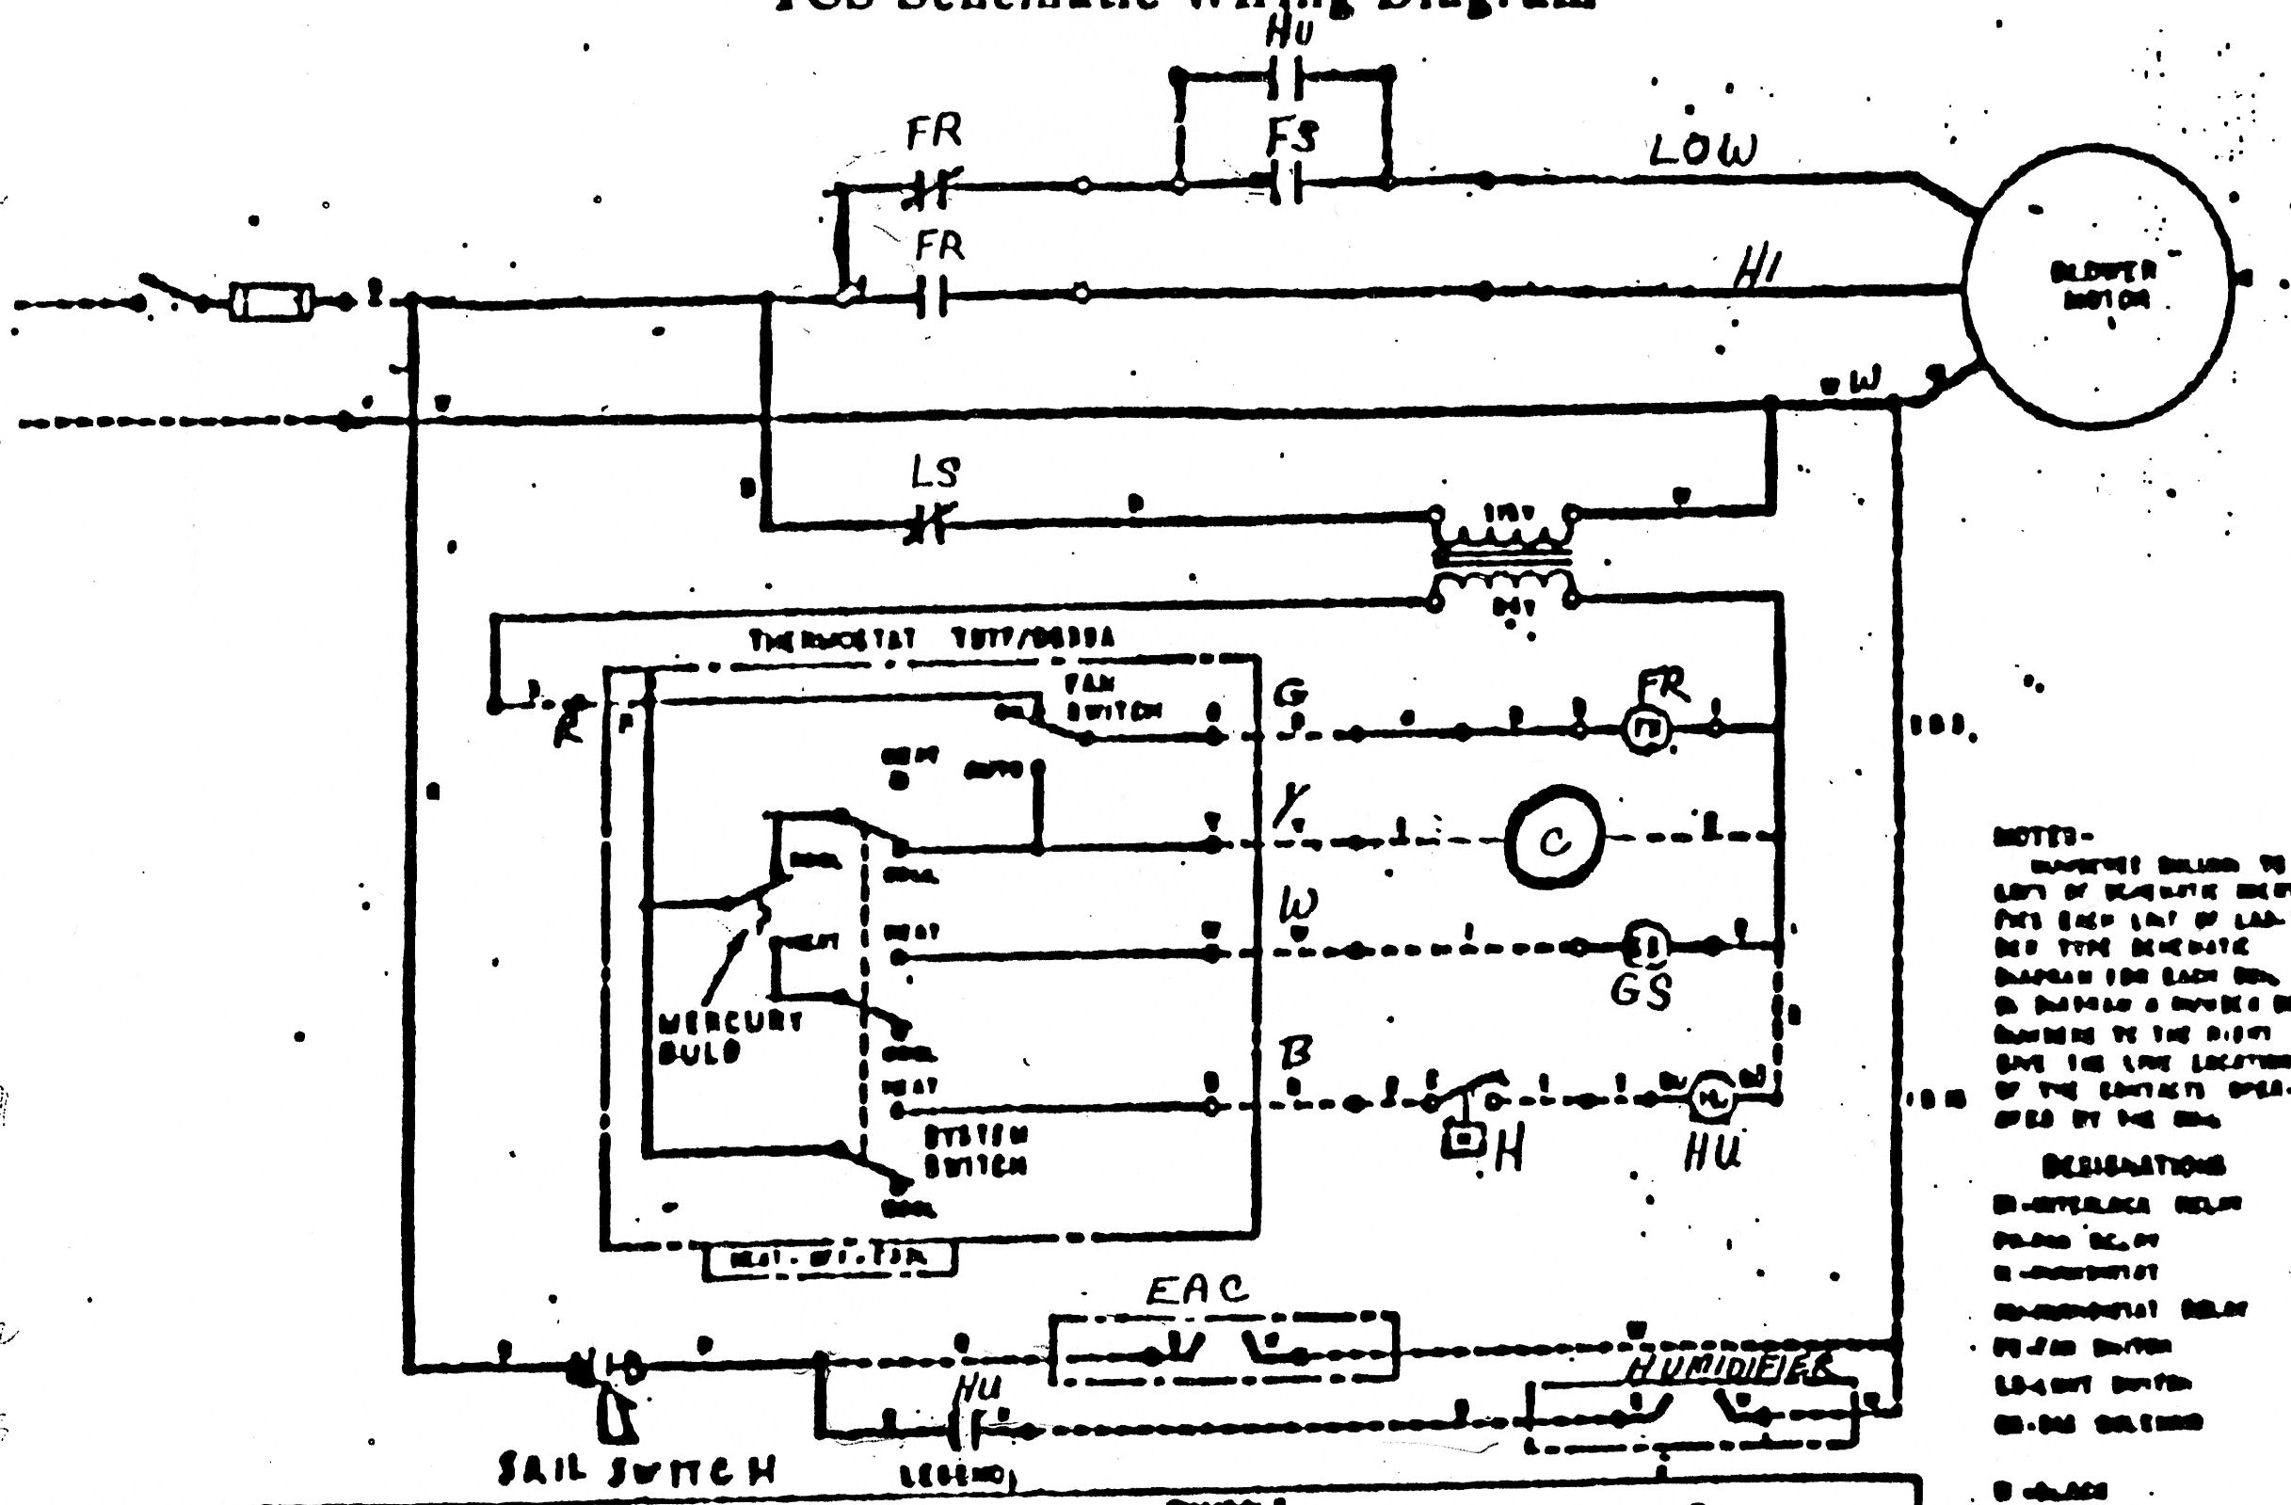

Slide 6
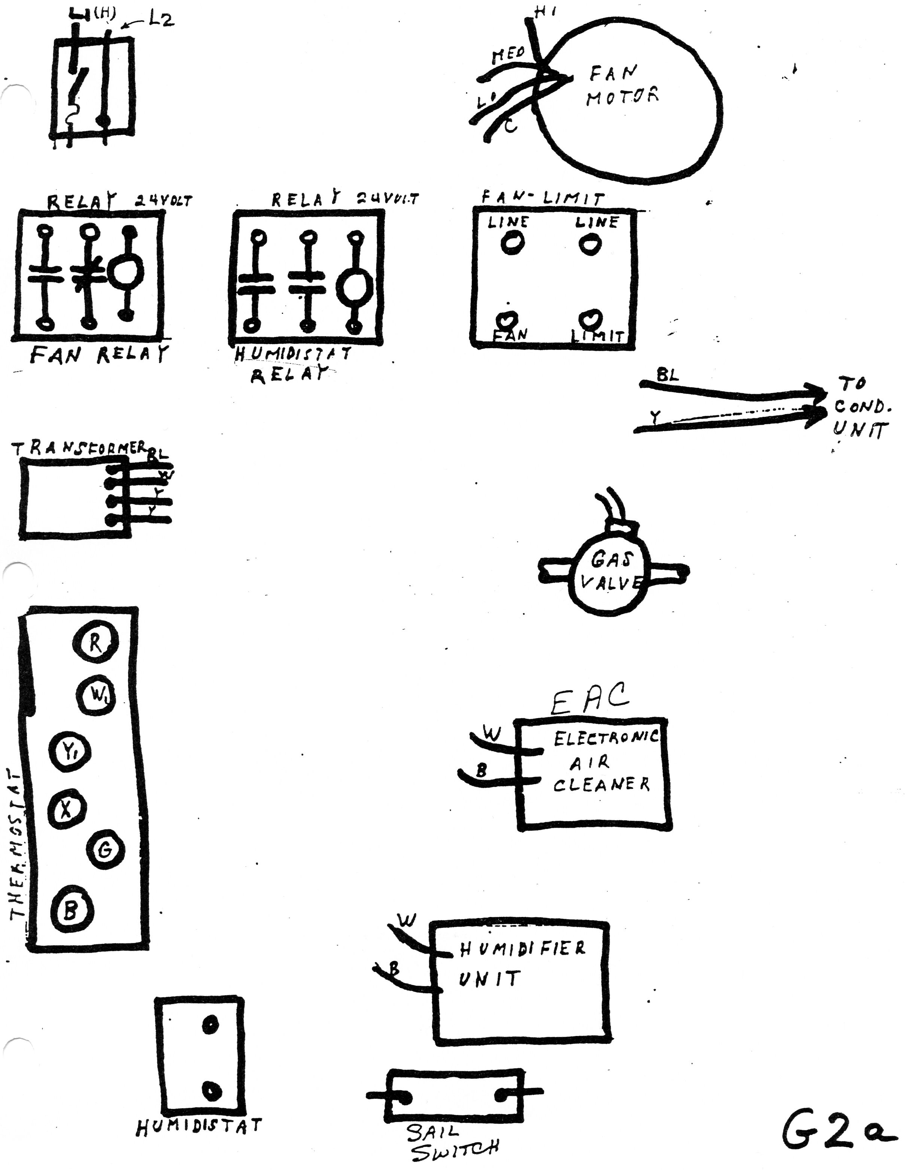

Slide 39
You have finished the LINE VOLTAGE Circuit.

Slide 40
The next slide shows your completed PICTORIAL and this is what you need to show your Instructor for credit.

Slide 42
WOW!
That was a lot of wires. I hope I can follow the wires correctly to wire this unit. If I can, you are good to go. If not, you have to do it again. In other words, you can’t be sloppy on this pictorial.

Slide 43
THE
END

